Slide 1

Our Community
December 28, 2020 - January 3, 2021
DISCLAIMER: This document is strictly private, confidential and personal to its recipients and should not be copied, distributed or reproduced in whole or in part, nor passed to any third party.

Slide 2
Problem Statement
What is the total annual grants in each of the 6 countries of interest?
What is the funding profile for each country? Categories and metrics of interest are listed in Appendix 1: Grants categories and metrics.
What information can be captured about each grant opportunity? Fields of interest are listed in Appendix 2: Grants details.
Which categories of funding are more transparent (have more data available) and which are more opaque (data not accessible)?
How have social and other nationally significant events (e.g. COVID-19, bushfires, Black Lives Matter, #metoo, climate emergency) impacted funding across each of the 6 countries of interest?
Ideal Output:
Automate some processes that are currently manual in Funding Centre
Provide ready access to data for Our Community to generate research reports for the public to develop a better understanding of the grants landscape and trends
Provide ready access to data for Our Community to understand the grants landscape as input to market research for SmartyGrants
:

Slide 3
Task 1/2/3/4
Task Managers - Gagan Bhatia, Jessica Becerra Formoso, Amal Matthew, Franz Taborlupa

Slide 4
Task 1 - Web Scraping and Data Collection
Task Manager - Gagan Bhatia

Slide 5
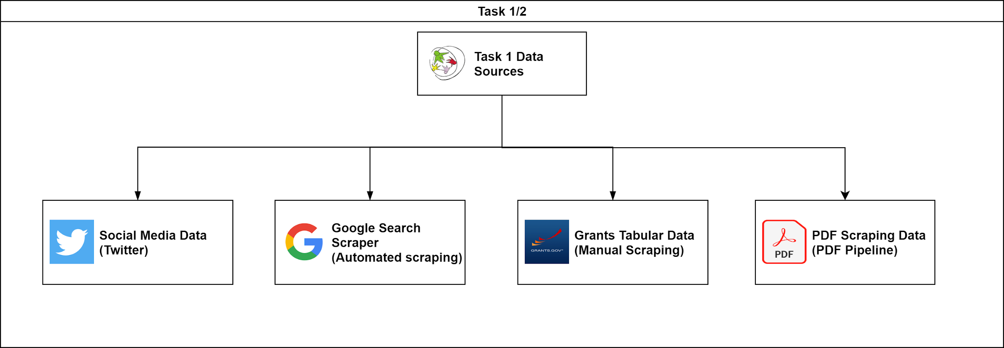
Work in Progress - Initial Findings
Task 1

Slide 6
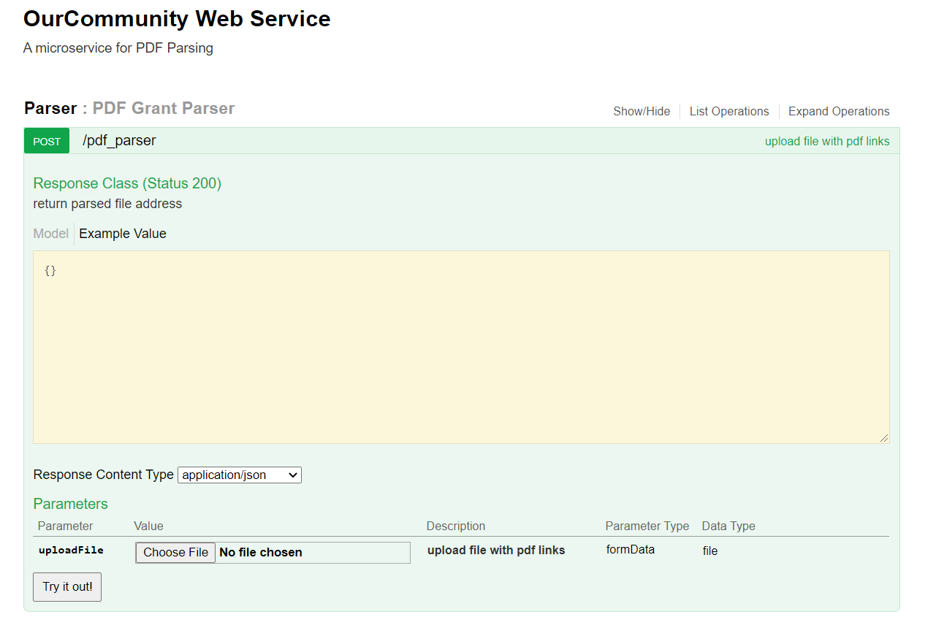
Work in Progress - PDF Pipeline
Task 1

Slide 7
Work in Progress - Next Steps
Complete the manual scraping for all remaining websites
Complete the PDF scraping website
Complete the Google search Apify scraper pipeline

Slide 8
Task 2b
#task2b_nlp_feature-extraction
Task Manager - Jessica Becerra Formoso

Slide 9
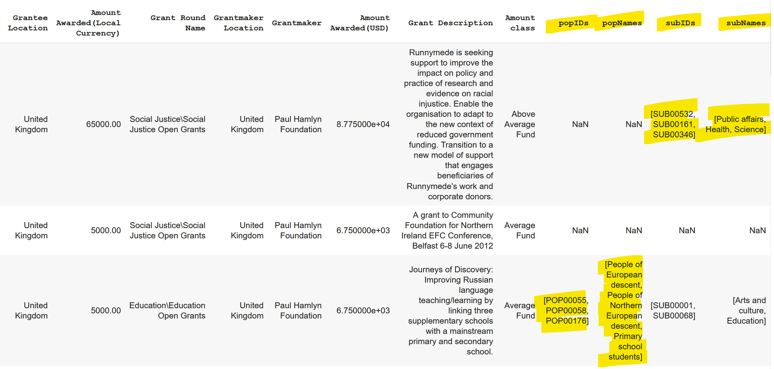
Task 2b - Feature Extraction
Progress this week:
CLASSIEfier API integration
completed:
- Adds four new columns to
our current datasets:
popIDs,
popNames,
subIDs,
subNames.
Notebook.

Slide 10
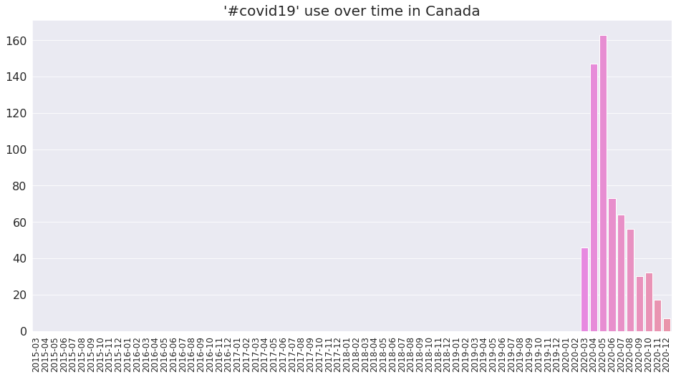
Task 2b - Feature Extraction
Progress this week:
Hashtag use exploration:
- Canada case.
4 twitter accounts. 12843 tweets. 14116 #s.
[('#innovation', 968),
('#canada', 654),
('#covid19', 635),
('#ai', 385),
('#socinn', 191),
('#walrustalks', 159),
('#ia', 143),
('#cifarvirtualtalk', 130),
('#bringingtheartstolife', 126),
('#conférencevirtuelleducifar', 115)]

Slide 11
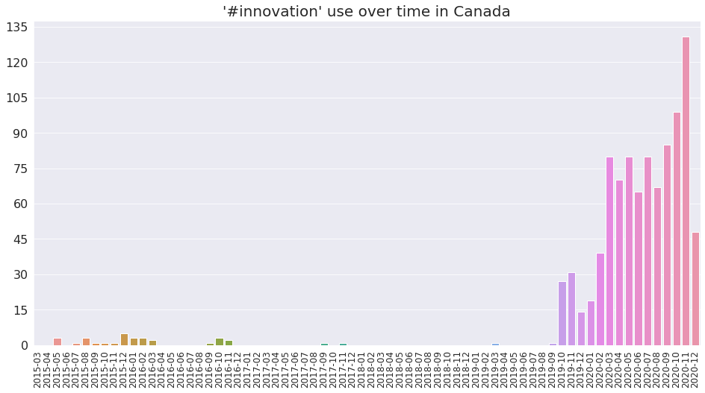
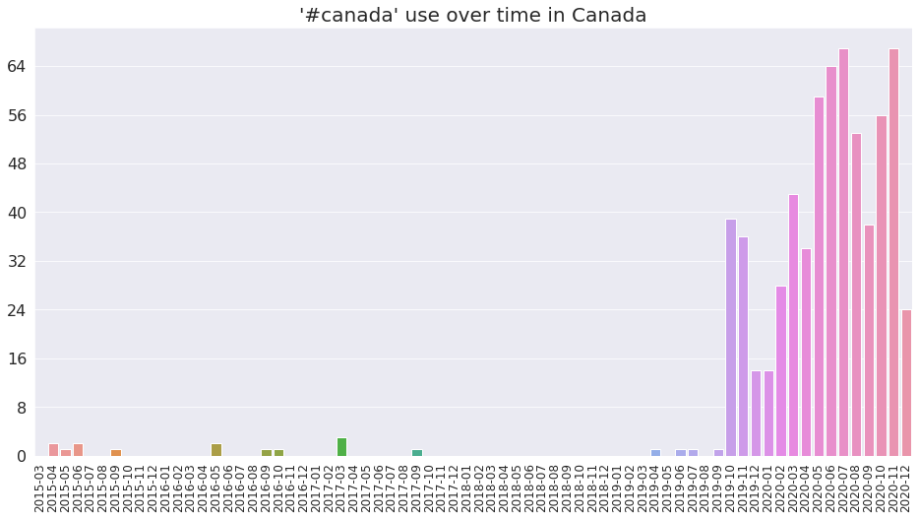
Task 2b - Feature Extraction
Notebook.

Slide 12
Task 2b - Feature Extraction
What’s next?
➜ Keep exploring the hashtag use case. What’s the picture for other countries?
➜ Support pdf pipeline. Extracting features from unstructured data.

Slide 13
Task 2a CSV Merging & Task 3 Data Visualisation
Task Manager : Amal Mathew

Slide 14
Task 2a -Updates so far..
Finished Merging 40+ csv’s each of which belong to different foundations.
Private foundations and Govt foundations were separated into two different csv’s.
Total private foundation -> more than 400k rows
Reduced bias on Uk data
Reduced Null values,currently present for Subject and Grant Round Name

Slide 15
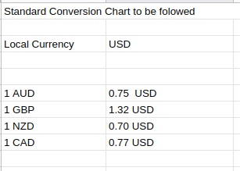
Newly Adopted labels for Amount class
Grant is None
Less than $1000
$1001 to $5000
$5001 to $50000
$50001 to $250000
$250001 to $500000
More than $500000

Slide 16
Task 2a -Next Steps...
Convert Regions into Countries using Location Api(as much as possible)
Create standard Local and Global Amount class

Slide 17
Task 3 Data Visulalisation
Basic analysis was done on initial data.
Plans to create Plotly dashboard and data studio dashboard for data visualization.
Need to organise works and distribute work more.

Slide 18
Weekly plans for subtasks and meetings
Work packages will be created for each type of visualization. There will be one responsible
person for the sub-task. They will be working with other team members on it
implementation.
Weekly Task03 meeting will be scheduled to go over progress/status/issues etc.
Expectation is that subtask responsible person will summarize their task and present to the task03 team.

Slide 19
Task 4
Task Manager - Franz Taborlupa

Slide 20
Task 4a Suggested Pipeline
Input & EDA
Modelling
Output = Classifier ML Model
Pre-processing
Sub-categories from OurCommunity
CLASSIE
Feature Engineering
Working with Task 2 to find features and apply to ML
Assess classification (need metrics from OurCommunity

Slide 21
Task 4b Suggested Pipeline
Input
EDA
Visualisation and Report
Pre-processing
Exploration
Feature Engineering
Cleaning of output
Connect to the dashboard

Slide 22
Task 06 Suggested Pipeline
User Research
Data Gathering
Building Dashboard
Quality Assurance
Sub-categories from OurCommunity
Stakeholder Interviews
CLASSIE
Working with Task 2 to find features and apply to ML
Assess classification (need metrics from OurCommunity
Assess classification (need metrics from OurCommunity

Slide 23
Work in Progress - Initial Findings
Timeline Setting
CLASSIE’s limitations
Discussion of output (Classifications and Recommender system)
Discuss Prediction, ℅ Amal
:

Slide 24
Our Process/Approach
Current Subtasks:
Task 04a - Topic Modelling
Task 04b - Timeseries Analysis
Task 06 - Building the Dashboard
Process
Went back to the problem statement to define main goal
Created a list of requirements
Discussions and refinements (current)
Find metrics for success indicators
Sprints and Scrum
Quality Assurance
Challenges
Discussing CLASSIE limitations and next steps right now
Need to discuss main output and dashboard needs from the user (Interviews of stakeholders)

Slide 25
Data Sources & Data Sets
Twitter Data: https://drive.google.com/drive/folders/1WAWhyTeClHwIFImiI_j6hzHq6T_fy5P4
Data from Webscraping ℅ Task 1: https://drive.google.com/drive/folders/1QQ9X3jiFhL0slaMe0ngUNNi5JWJ2XLIC

Slide 26
Next Steps...
Solidifying the Timeline
Discuss on prioritisation and needed output
Discuss about the dashboard Needs
Stakeholder interviews
Ask for an example of the Dashboard right now for Funding Centre
Discuss the need of a recommender system
Create a task for Recommender system

Slide 27
Methods, Models and Tools
*** All relevant code should be included in relevant Omdena Github page, and link provided***
Examples:
Manual Data Collection from XYZ sources (can reference data sources slide)
Public Available Datasets such as (can reference data sources slide)
Automatic Data Collection from XYZ sources (can reference data sources slide)
Data wrangling using …. to ….
Sentiment analysis using data scraped from Twitter
Topic modeling, Clustering
Image classification
Use Python to …..
Neural network models for computer vision, including Mask R-CNN and a range of U-Net variations
Sentiment analysis using xyz...creating word cloud
Random forest / Decision tree /K means clustering
Image resolution improvements using Deep Image Prior and Decrappify
Labelbox for image annotation
Additional training and data augmentation using mixup

Slide 28
Limitations & Further Scope
Optional slide - limitations/drawbacks to data sets, for ex. Possible biases. Possible solutions to address these issues.
Challenges Section: What was the challenge faced in this project, how did we overcome it? Eg, image resolution
Avoiding Pitfalls: lessons learned

Slide 29
Task 4 / Topic Modelling
Brief Task Description - Organised and Planned out next steps, created subtasks for further outcomes
Overview of Key Data Sources - Merged csvs with classifications and Twitter Data (need help with pre-processing)
Overview of Methods/Tools - CLASSIE, Classification, Keyword Extraction, Dashboard
Result for this week: An outline of tasks and timeline for the tasks

Slide 30
Active Collaborators
Tintu Mary George Natacha Braz
Salma Nasir Pratyush Priyadarshi
Franz Taborlupa Ruth Ann Cabria
Bisman Singh Dmitri Gourianov
Jessica Becerra Formoso Carlos Rosas
Gagan Bhatia Ze-Pei Cian
Amal Mathew Marehan Refaat
Sawsan Alshaghel Luz SM

Slide 31
Work in Progress - Next Steps
*NOTE - This slide is for “work in progress” - it will be deleted/replaced with Final Results slides for Final version
Can include - Open Questions, Decisions to Make etc.

Slide 32
Results & Visualizations
All images should be labeled with data source, tool/methods
1 or 2 images per slide max
ALL Charts & Images should be explained - what did you do to generate this? Why did you do it? What does it tell the viewer? What are some key findings/take-aways from this? What is missing?

Slide 33
Results & Visualizations
Example: - chart showing Data set / Classifier/Accuracy
Dataset Name | Classifier Name | Accuracy
Climate44 | Correlated Topic Modeling | Unclear topics
Sentiment140 | Topic modelling | Unclear topics
Combined Climate Change, Global Warming & Nuclear Energy | KMeans Clustering | Found clear separate clusters
Climate44 | ULMFIT language model | 0.72
Sentiment140+Climate44* | LSTM | 0.79
Climate44* | BERT | 0.94

Slide 34
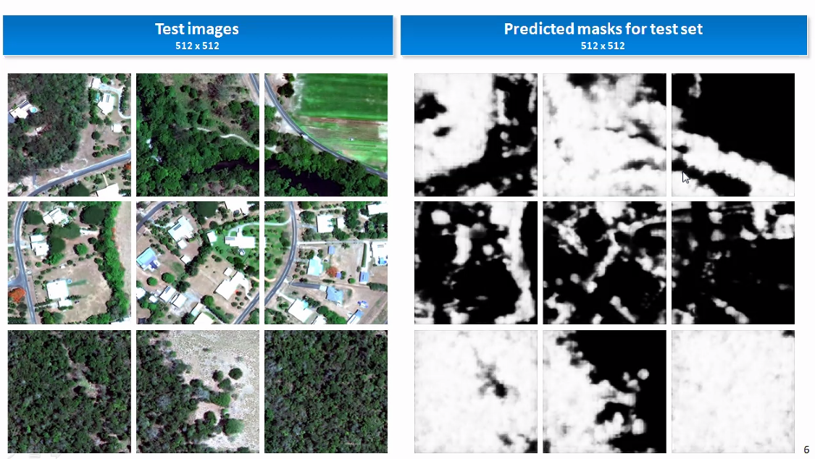
Results & Visualizations
Example: Our goal was to train a model to identify and label individual trees in images. We experimented with multiple neural network models for computer vision, including Mask R-CNN and a range of U-Net variations.
The image below shows results from the most successful approach - a basic Deep U-Net CNN solution - which reached 94% accuracy. The image show trees in white & non tree areas in black. This model could identify trees in new images, and even distinguish between forest shadows and trees.

Slide 35
Feedback - Comments & Lessons Learned
This is a great place for your general thoughts, comments and feedback. These should be shared INTERNALLY ONLY - with Omdena. Do NOT need to be included in any client facing presentations.
Let us know what worked for you in the process, and what could have gone better.
Is there anything you would like future collaborators to know?
We’re building a Resource Library for collaborators - what would you add/include? Which tools, methods & data sources were most useful for this project - and for future similar projects?

